Slide 1
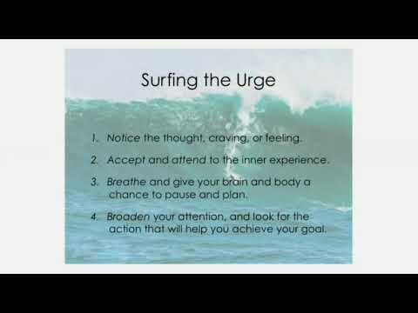
Educational
.
Authenticity
Two versions of yourself have competing goals
Do you think you should look after your future self?
Write a letter from your future self to your present self
Failure is a good thing
An extra hour of sleep makes you more resilient
Discussion
For a willpower failure
1.Be mindful of what you are thinking and feeling
2.Common Humanity (We feel that we are broken)
3.Encouragement over criticism
How do you deal with failure
Look for the first opportunity to recommit to your goal
Um
Use your breath as a source of stability
Knowing this lets you listen for it
…
Christopher Bauman – www.chrisbauman.com.au

Slide 2
1. What is a task that challenges your willpower ____________________________________________________________________________________________?
Advanced Question Words
2. What is something that you don’t want to do? ___________________________________________________________________________________________ ?
Decisions
Mindset
3. How can you sleep more?(Meditation) ___________________________________________________________________________________________ ?
Immediate gratification
Shape behaviour
4 When we are beating ourselves up we are more likely to drop the ball again with the things that we should be doing ___________________________________________________________________________________________ ?
Ruminating?
5. What advice would you give someone who suffered a setback?
___________________________________________________________________________________________ ?
Sleep intervention?
.
goal
6. What questions would you like to ask your future self ___________________________________________________________________________________________ ?
Craving
Surfing the urge – knowing you can overcome an obstacle
7. Can you imagine yourself grocery shopping in the future ___________________________________________________________________________________________ ?
8. What is an excuse that you have made in the past / How close are you to your goal? ____________________________________________________________________________________________ ?
Falling off the wagon
pessimism
Stress tolerance – the ability to stay put when things get uncomfortable
failure
Christopher Bauman – www.chrisbauman.com.au

Slide 3
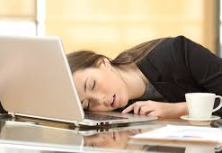
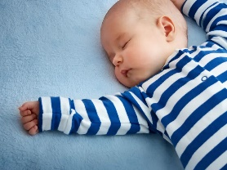
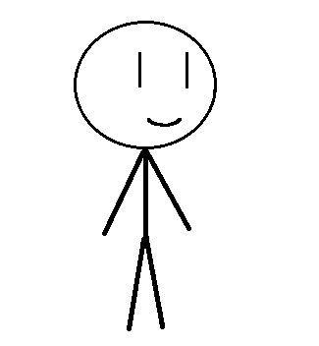
Forgive yourself if you suffer a willpower setback
Intervention
Willpower failure
feel guilty
not feel guilty
Predict a failure you may have
How do you fail?
Draw your future self

